Slide 1
Diffusion-Based Vocoders
2nd May 2023

Slide 2
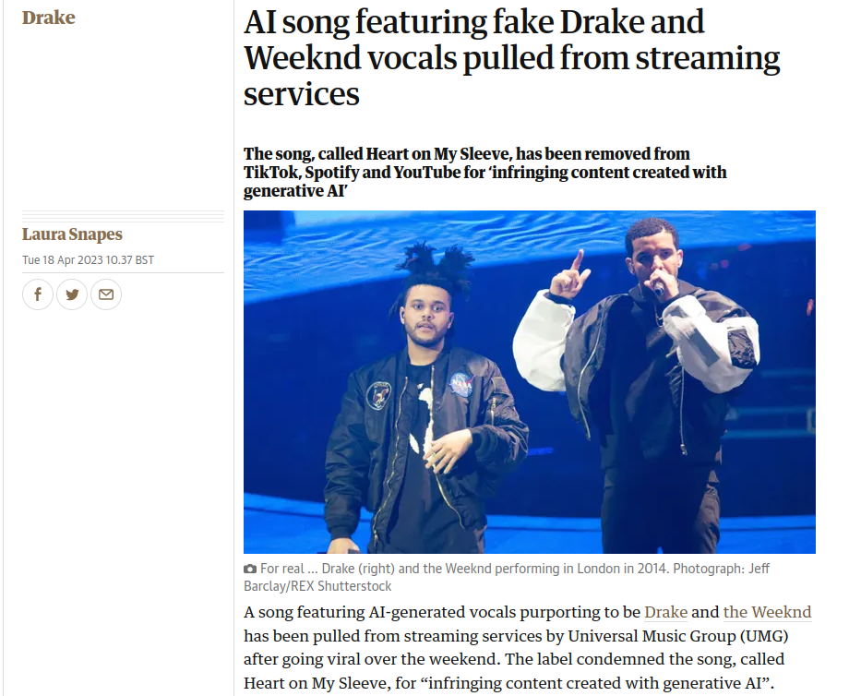
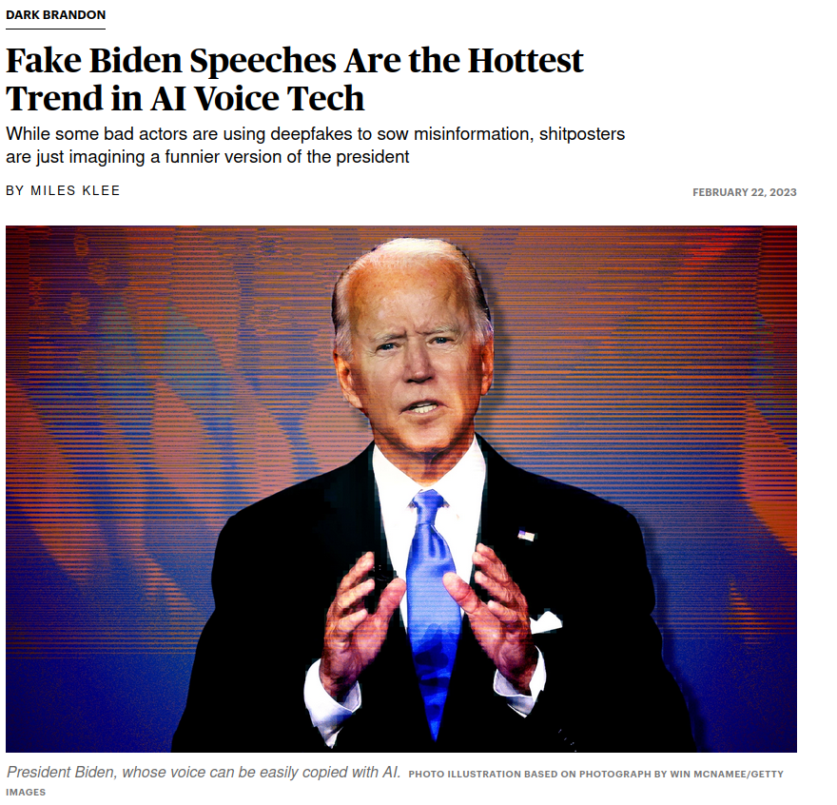

Slide 3
Deep Learning-Based Speech Synthesis
Generally split into two parts:
Text-to-speech (TTS) model:
Text ⟶ characters/phonemes ⟶ acoustic features (usually mel-spectrograms)
Vocoder
Acoustic features ⟶ time-domain waveform (i.e. audio)

Slide 4
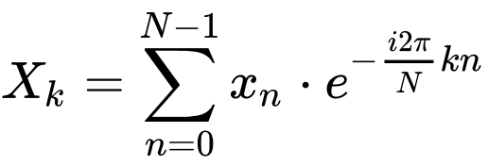
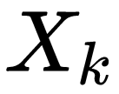
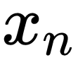
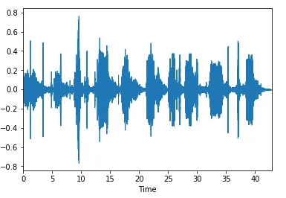
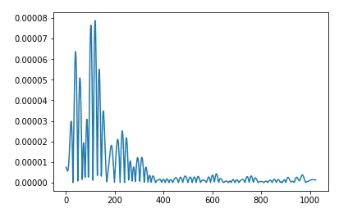
Audio Representations - Fourier Transform
Time-Domain, ( ) )
Frequency-Domain, ( )
(Discrete)
Fourier Transform

Slide 5
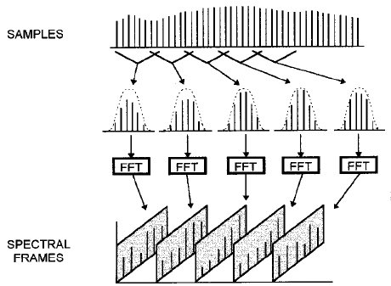
Audio Representations – Short-Time Fourier Transform

Slide 6
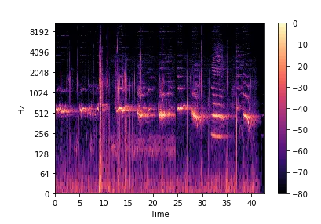
Audio Representations – Short-Time Fourier Transform
Spectrogram
(dB)
https://towardsdatascience.com/getting-to-know-the-mel-spectrogram-31bca3e2d9d0

Slide 7
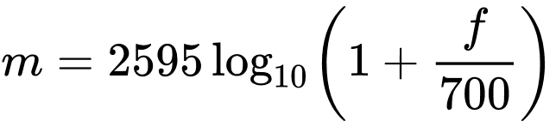
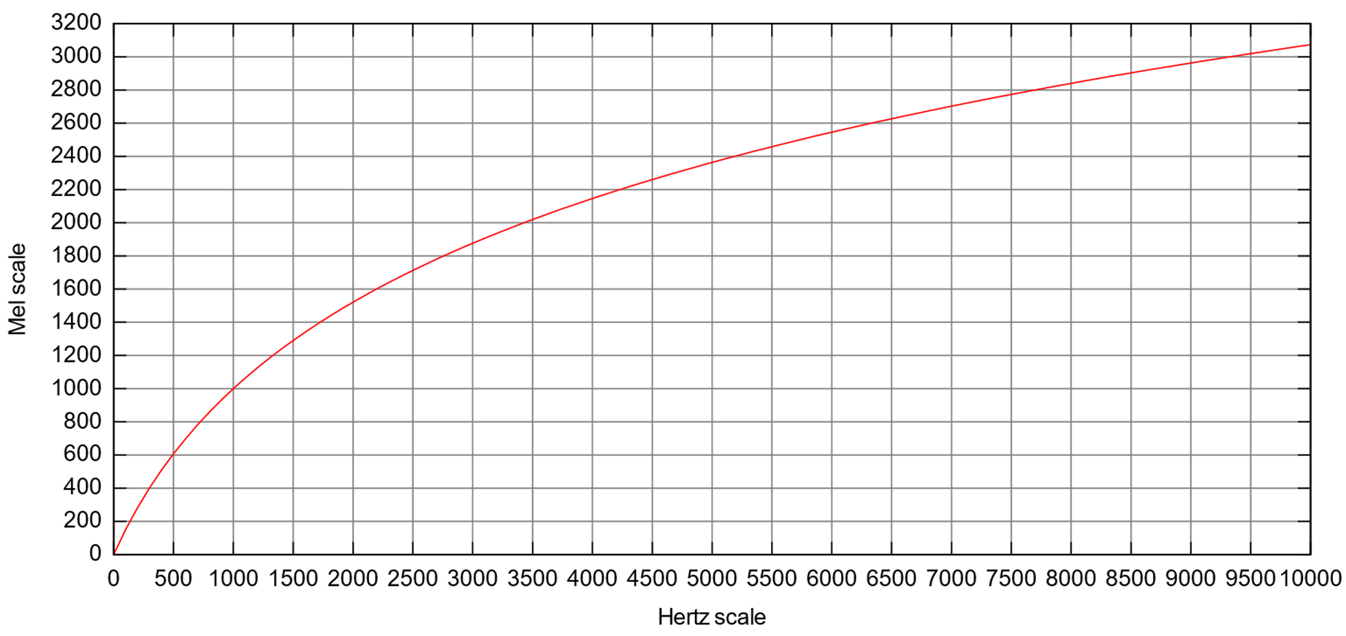
Mel-Spectrogram
Convert frequencies from Hz to the log-based mel scale.
Better captures aural information as humans process it.
More focus is given to differences between low frequencies than between high frequencies.

Slide 8
Vocoders
Vocoders are used to convert from (mel-) spectrograms to waveforms.
This is non-trivial for a few reasons:
Finite resolution of spectrograms
Finite sample-rate of desired waveform
Information lost in windowing process of STFT (especially if windowing filters are used)
Fourier transform outputs are complex-valued, but we only plot the power (i.e. modulus) in a spectrogram—the phase (i.e. argument) of each frequency bin is lost.

Slide 9
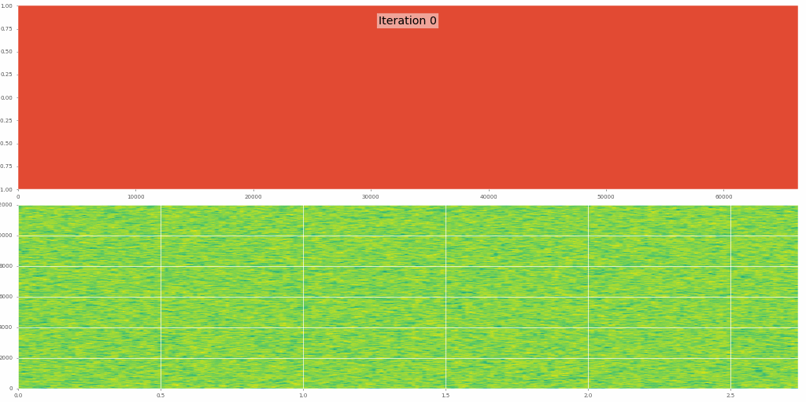
Neural Vocoder Approaches
RNNs (e.g. with LSTM [1])
GANs (e.g. WaveGAN [2])
Autoregressive models (e.g. WaveNet [3])
Good, but slow!
Diffusion models (e.g. DiffWave [4] & WaveGrad [5])
Non-autoregressive and therefore faster to sample from (we hope)

Slide 10
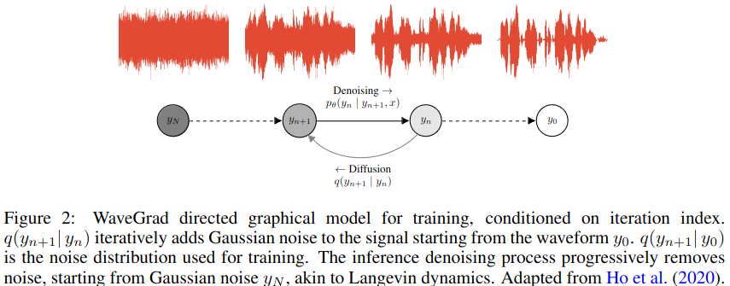
Diffusion Models

Slide 11
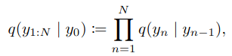
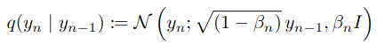
Diffusion Models
The diffusion process is defined through the Markov chain:
which adds Gaussian noise at each iteration, for some fixed constant noise schedule , via

Slide 12
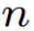
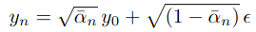
Diffusion Models
We can write the output of the diffusion (forward) process at any time step as:

Slide 13
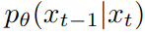
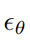
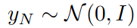
Diffusion Models
In the denoising (backwards) process , we use a neural net to predict some that can be used to repeatedly denoise samples (with the first sample originally taken from a standard Gaussian distribution: ).

Slide 14
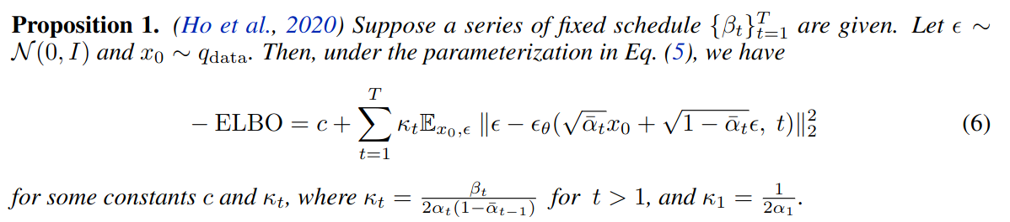
Diffusion Models
We train this neural net by optimising the ELBO, which can be written as follows (using derivations in [6]):

Slide 15
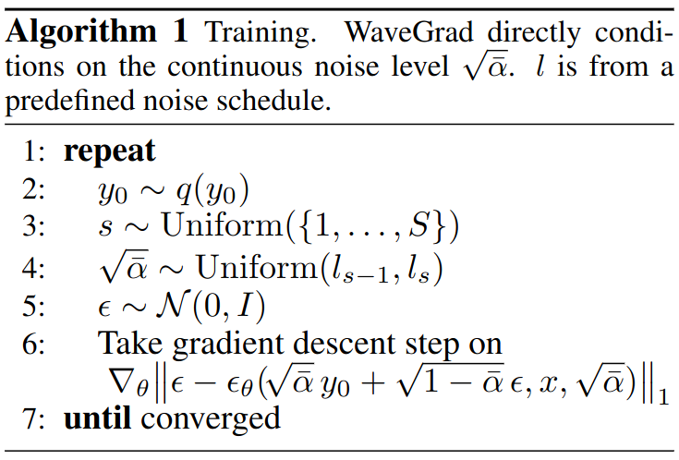
WaveGrad Training

Slide 16
WaveGrad Training
The authors found improved performance by making a few alterations:
Training with a continuous hierarchical noise schedule
Optimising an L1 norm rather than an L2 norm

Slide 17
WaveGrad Training
The authors found improved performance by making a few alterations:
Training with a continuous hierarchical noise schedule
Optimising an L1 norm rather than an L2 norm
We condition on acoustic information (e.g. Mel spectrogram) and also provide the neural net with information of the time/noise schedule.

Slide 18
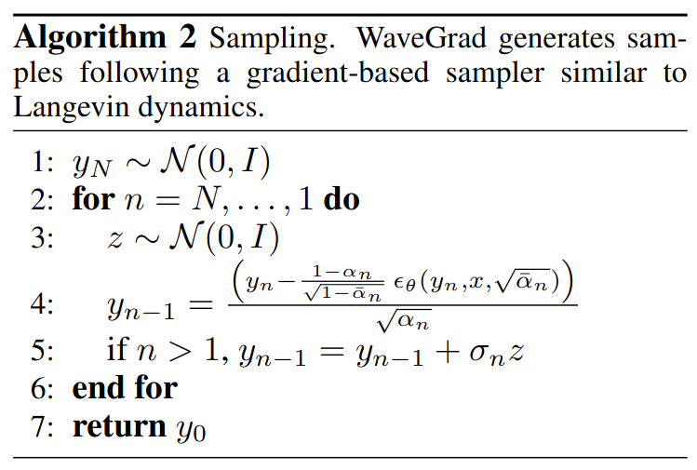
WaveGrad Sampling
Sampling denoises pure Gaussian noise.
In step 4 we're subtracting the noise from our previous sample , along with some scaling based on the noise schedule.
We add some extra noise in all steps other than the final (when n=1).

Slide 19
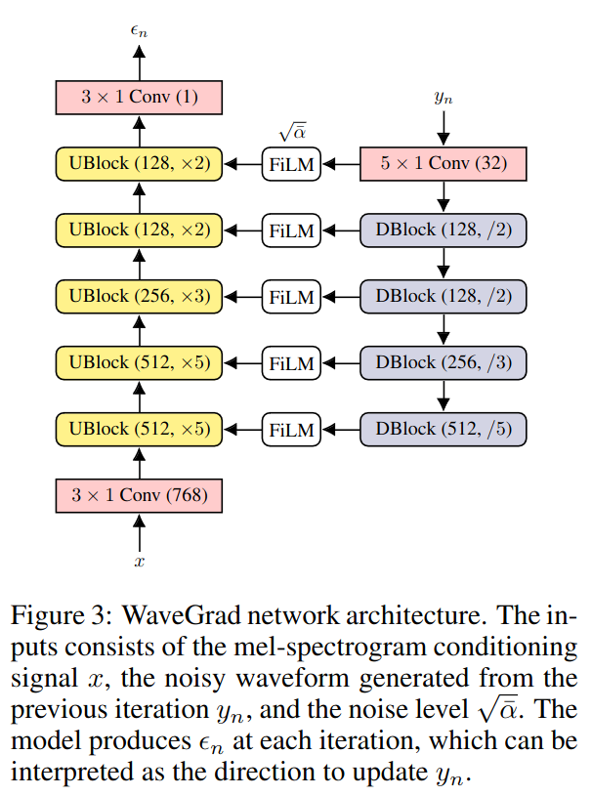
WaveGrad Architecture
Downsampling and upsampling blocks help to share sample information across time.
The feature-wise linear modulation (FiLM) modules also use positional encodings of information from the noise schedule via .

Slide 20

WaveGrad Samples
Conditioned on ground-truth mel-spectrogram
Ground truth audio
With 1000 denoising steps
With 25 denoising steps
WaveFlow (autoregressive model)

Slide 21
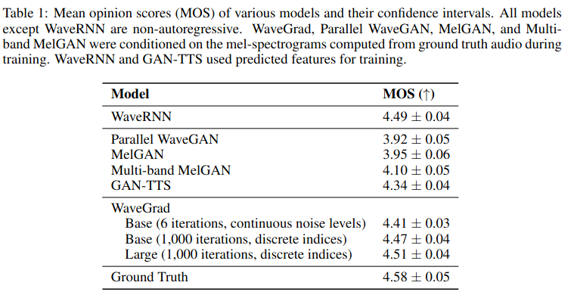
WaveGrad Results

Slide 22
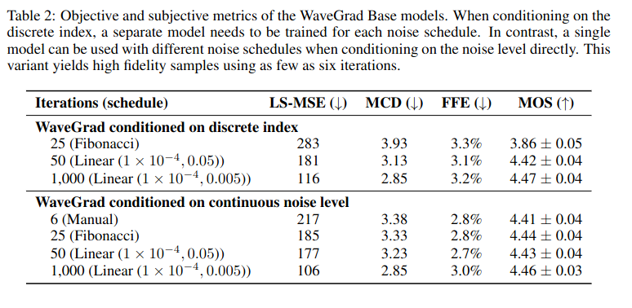
WaveGrad Results

Slide 23
WaveGrad Results
LS-MSE—Log Mel-spectrogram Mean Squared Error

Slide 24
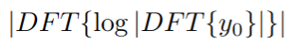
WaveGrad Results
LS-MSE—Log Mel-spectrogram Mean Squared Error
MCD—Mel Cepstral Distance:
MSE between (mel-scaled) cepstral coefficients given by
in ground truth and generated signals.
DFT = Discrete Fourier Transform

Slide 25
WaveGrad Results
LS-MSE—Log Mel-spectrogram Mean Squared Error
MCD—Mel Cepstral Distance:
MSE between (mel-scaled) cepstral coefficients given by
in ground truth and generated signals.
DFT = Discrete Fourier Transform
FFE—F₀ Frame Error:
Percentage of windows/frames in spectrogram with incorrectly identified fundamental (strongest) frequency F₀.

Slide 26
WaveGrad Results
LS-MSE—Log Mel-spectrogram Mean Squared Error
MCD—Mel Cepstral Distance:
MSE between (mel-scaled) cepstral coefficients given by
in ground truth and generated signals.
DFT = Discrete Fourier Transform
FFE—F₀ Frame Error:
Percentage of windows/frames in spectrogram with incorrectly identified fundamental (strongest) frequency F₀.
4. MOS—Mean Opinion Score

Slide 27
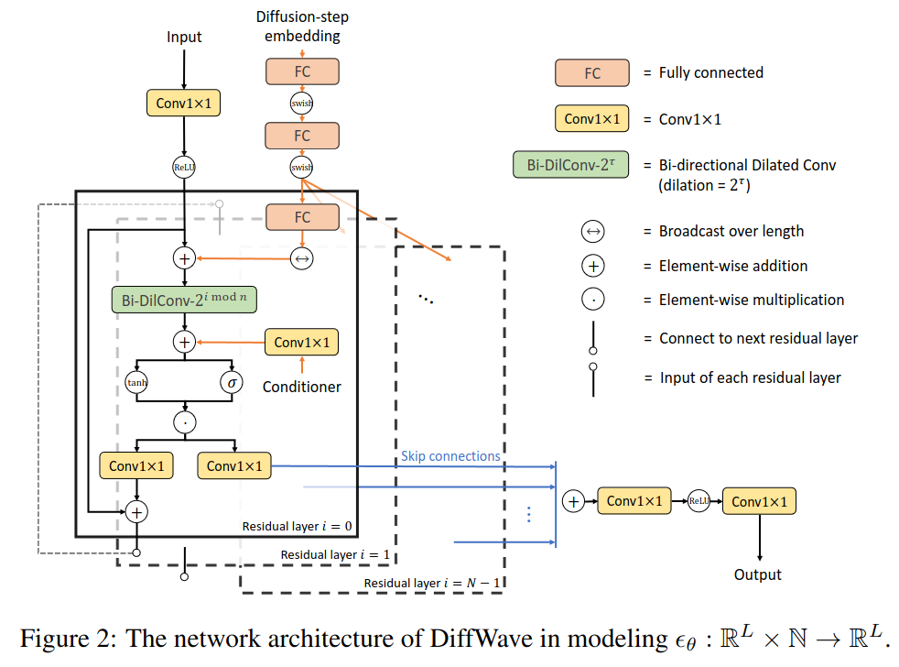
DiffWave Architecture

Slide 28
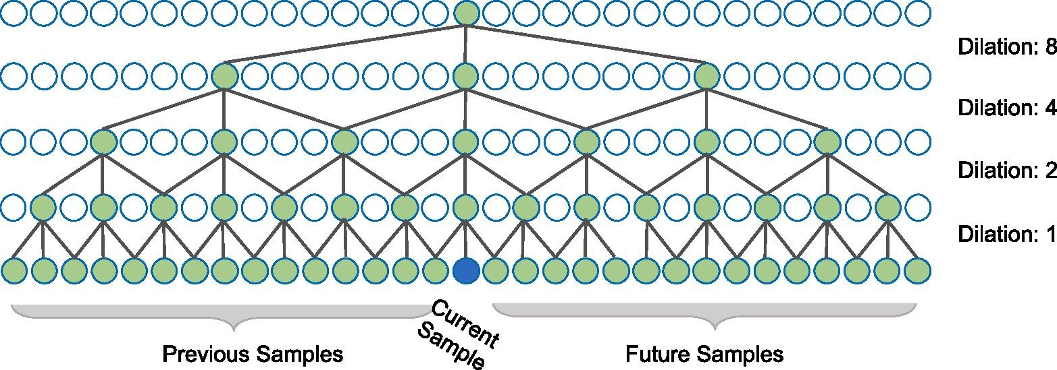
DiffWave Architecture
Bidirectional-dilated convolution stacks:
Serve similar purpose to WaveGrad's upsampling/downsampling blocks—sharing sample information over time

Slide 29
DiffWave Conditioned on Mel-Spectrogram
Ground truth
DiffWave
WaveGlow (autoregressive model)

Slide 30
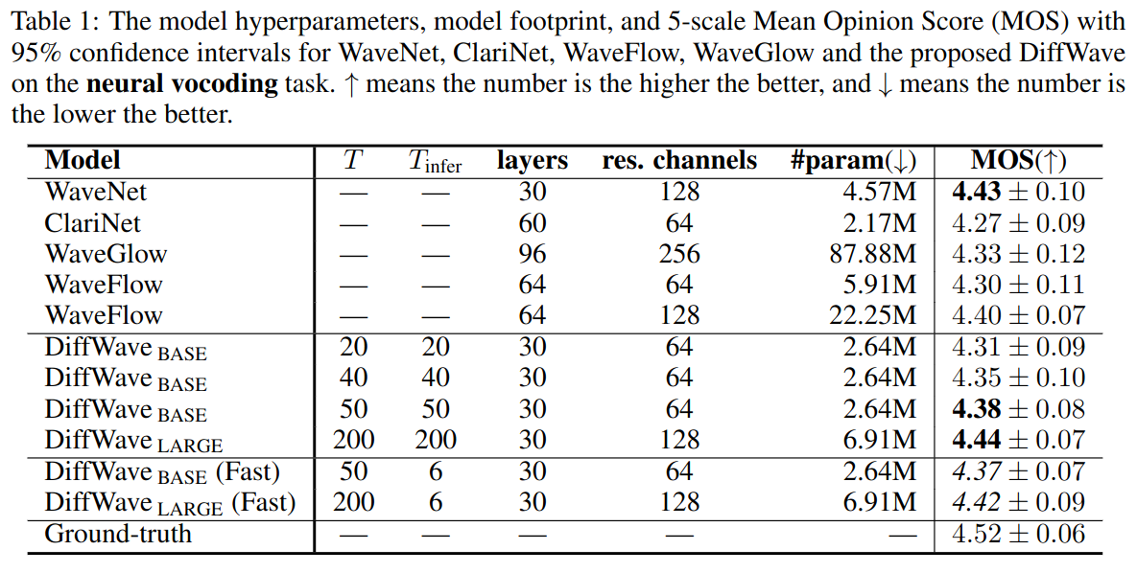
DiffWave Conditioned on Mel-Spectrogram

Slide 31
DiffWave Conditioned on Class Labels
Trained on dataset of digits spoken aloud in English by a variety of speakers (a subset of the Speech Commands dataset [7]).
Conditioned on class label (digit).
WaveNet
DiffWave

Slide 32
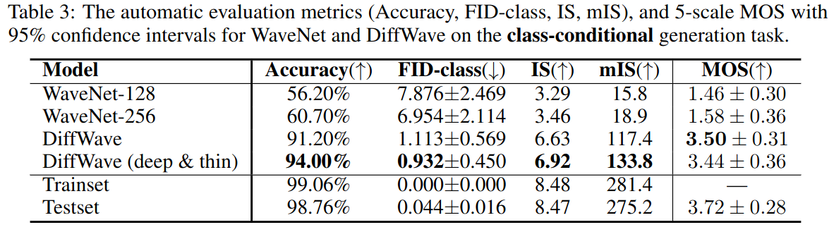
DiffWave Conditioned on Class Labels
Accuracy: classification accuracy of a ResNeXT classifier [8].
FID (Fréchet Inception Distance):
2-Wasserstein distance between 1024-long vectors produced by ResNeXT for training set and set of generated samples.
IS (Inception Score):
"measures both quality and diversity of generated samples, and favors generated samples that can be clearly determined by the classifier".
mIS (modified Inception Score):
"measures the within-class diversity of samples in addition to IS"

Slide 33
DiffWave Unconditional Generation
Trained on same subset of Speech Commands [7] as before but with no conditioning information.
WaveNet
WaveGAN
DiffWave

Slide 34
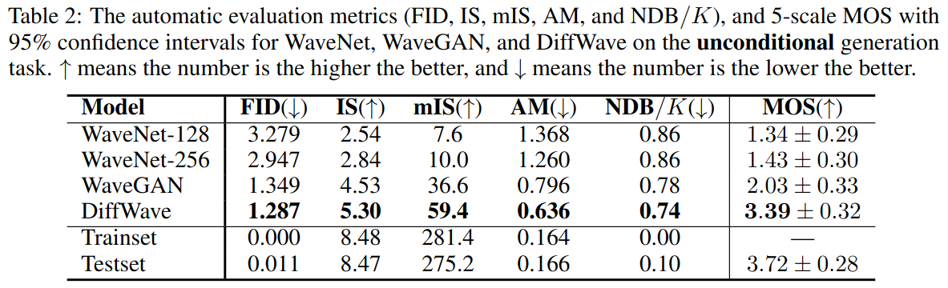
DiffWave Unconditional Generation
AM (Activation Maximization) Score:
"takes into consideration the marginal label distribution of training data compared to IS"
NDB (Number of Statistically-Different Bins):
"measures diversity of generated samples"
(K = number of K-means clusters involved in measuring the diversity of samples)

Slide 35
DiffWave Interpolation
Interpolate between two samples (of the same class) at t=50 (i.e. with 50 more denoising steps left).
Example 1
Sample 1
Sample 2
Interpolation (50/50)
Example 2
Sample 1
Sample 2
Interpolation (50/50)

Slide 36
Conclusion
Diffusion models present versatile and lightweight neural vocoders.
Having a large number of denoising steps can take a lot of time.
Solution: 'DiffWave(Fast)' parameterisation of the diffusion model that obtains good samples after just T=6 denoising steps.
Similar work has since been done on music synthesis, e.g. Google's "Multi-Instrument Music Synthesis With Spectrogram Diffusion" [9].
Conditioning on spectrograms and MIDI (using musical notation).

Slide 37
References
[1] Zen, Heiga, Yannis Agiomyrgiannakis, Niels Egberts, Fergus Henderson, and Przemysław Szczepaniak. ‘Fast, Compact, and High Quality LSTM-RNN Based Statistical Parametric Speech Synthesizers for Mobile Devices’. arXiv, 22 June 2016. http://arxiv.org/abs/1606.06061.
[2] Oord, Aaron van den, Sander Dieleman, Heiga Zen, Karen Simonyan, Oriol Vinyals, Alex Graves, Nal Kalchbrenner, Andrew Senior, and Koray Kavukcuoglu. ‘WaveNet: A Generative Model for Raw Audio’. arXiv, 19 September 2016. http://arxiv.org/abs/1609.03499.
[3] Kong, Zhifeng, Wei Ping, Jiaji Huang, Kexin Zhao, and Bryan Catanzaro. ‘DiffWave: A Versatile Diffusion Model for Audio Synthesis’. arXiv, 30 March 2021. http://arxiv.org/abs/2009.09761.
[4] Donahue, Chris, Julian McAuley, and Miller Puckette. ‘Adversarial Audio Synthesis’. arXiv, 8 February 2019. http://arxiv.org/abs/1802.04208.
[5] Chen, Nanxin, Yu Zhang, Heiga Zen, Ron J. Weiss, Mohammad Norouzi, and William Chan. ‘WaveGrad: Estimating Gradients for Waveform Generation’. arXiv, 9 October 2020. http://arxiv.org/abs/2009.00713.
[6] Ho, Jonathan, Ajay Jain, and Pieter Abbeel. ‘Denoising Diffusion Probabilistic Models’. arXiv, 16 December 2020. http://arxiv.org/abs/2006.11239.
[7] Jia, Ziyue, Linfeng Yang, Zhenrong Zhang, Hui Liu, and Fannie Kong. ‘Sequence to Point Learning Based on Bidirectional Dilated Residual Network for Non-Intrusive Load Monitoring’. International Journal of Electrical Power & Energy Systems 129 (1 July 2021): 106837. https://doi.org/10.1016/j.ijepes.2021.106837.
[8] Saining Xie, Ross Girshick, Piotr Dollár, Zhuowen Tu, and Kaiming He. Aggregated residual transformations for deep neural networks. In Proceedings of the IEEE conference on computer vision and pattern recognition, pp. 1492–1500, 2017
[9] Hawthorne, Curtis, Ian Simon, Adam Roberts, Neil Zeghidour, Josh Gardner, Ethan Manilow, and Jesse Engel. ‘Multi-Instrument Music Synthesis with Spectrogram Diffusion’. arXiv, 12 December 2022. http://arxiv.org/abs/2206.05408.

